Slide 1
Diabetes Analysis
Presented by: Trevor Allison, Madeleine Cope, Sanyam Jain, Julia Peitsch, and Raffi Mannarelli

Slide 2
11.3%
The Problem
8.5 million
1.5 million
Of the U.S. population has diabetes
People have undiagnosed diabetes
Deaths are attributed to diabetes each year (worldwide)
Notes:
Sources:
https://www.cdc.gov/diabetes/library/spotlights/diabetes-facts-stats.html#:~:text=37.3%20million%20Americans%E2%80%94about%201,t%20know%20they%20have%20it.
https://www.who.int/health-topics/diabetes#tab=tab_1

Slide 3
Overview
Dataset
1
Models
2
Analysis
3
Summary
4

Slide 4
Dataset
Description
Limitations
Factors that might predict the incidence of diabetes:
Health Status Indicators
Lifestyle Factors
Health Care Access
Demographics
Non-Numerical & Categorical data
Imbalanced Dataset

Slide 5
Models
KNN
Random Forest
Boosting
Notes:
In order to make accurate predictions on the relationship between the listed variables and having diabetes, it is important to conduct multiple tests and compare the data presented. We conducted a boosting test, random forest test, regression test, and x,y,z. After completing each test, we analyzed each of the results and presented our findings.

Slide 6
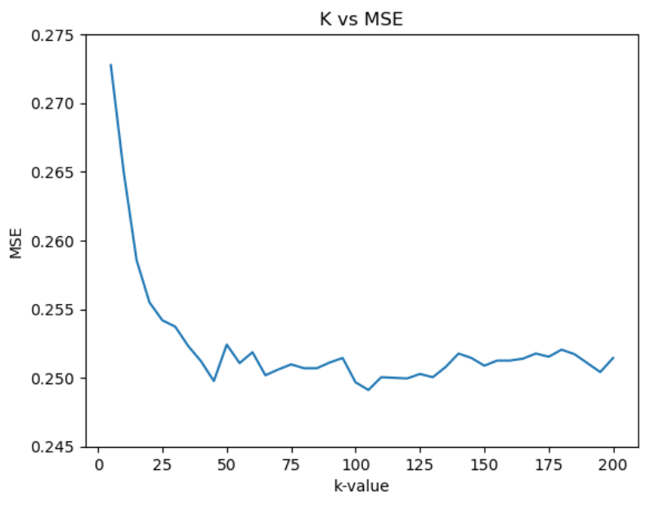
KNN
Details
Finds K points in the training dataset nearest to each x.
Produces classifiers close to the optimal Bayes classifier
Results
k= 5
Accuracy: 72.7%
MSE: 0.272
k= 100
Accuracy: 75%
MSE: 0.249
k= 200
Accuracy: 74.85%
MSE: 0.251
k= 25
Accuracy: 74.58%
MSE: 0.254

Slide 7
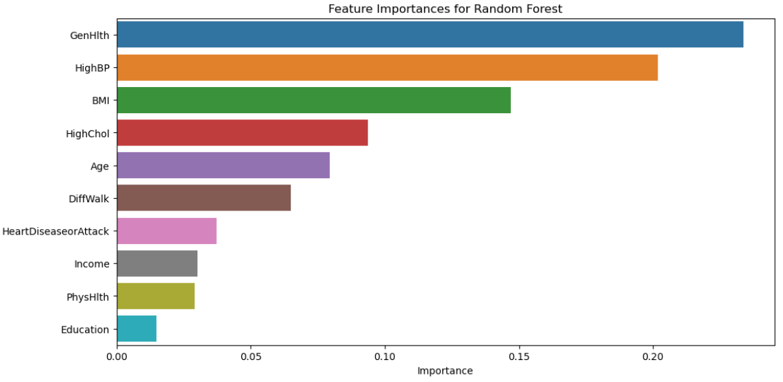
Random Forest
Details
Only a subset of predictors are considered at each split
Results in a reduction in variance and higher reliability
Highly accurate, typically
Results
Accuracy: 76.6%
MSE (out of sample loss): 0.234
Model Recall: 0.553
Best Parameters :
{'max_depth': 10, 'min_samples_split': 10, 'n_estimators': 200}
Notes:
The random forest test aids in the illustration of important variables. In reference to the tests that were conducted, it is evident that ____.
gives a measure of variable importance
Uses a random samples of subsets
Discuss the results
Dive into the numbers and explain what they mean
Was it a good predictor
See page 344 and 345 in textbook for details
Model recall: number of true pos/ true pos + false negatives

Slide 8
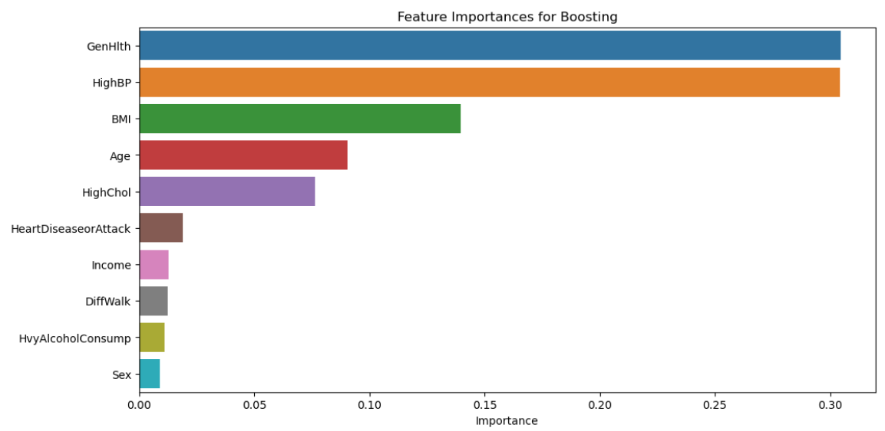
Boosting
Details
Trees are grown sequentially (using information from previous trees)
Each tree is fit on a modified version of original data (no bootstrapping)
Model learns slowly – high performance
Results
Accuracy: 76.75%
MSE (out of sample loss): 0.232
Model Recall: 0.592
Best Parameters :
{'learning_rate': 0.1,
'max_depth': 3,
'n_estimators': 200}
Notes:
Next, we analyzed the boosting method, and compared it to the findings that resulted from the random forest. Boosting also gives us a measure of variable importance.
Why was it a better or worse predictor (was it similar to the random forest test)?
Discuss what results were found and what they mean
Did it provide an accurate prediction to those who had diabetes
See pages 345 and 346 in textbook for more info on the model

Slide 9
Analysis
Important Variables:
Random Forest
Boosting
KNN
How should we proceed with these insights?
Notes:
Featured importances for random forest:
General Health
BMI
High Blood Pressure
Featured importances for boosting:
High Blood Pressure
General Health
BMI
How to proceed:
Exercise frequently
Maintain a good diet
Get cholesterol checked every 4-6 years
Get blood pressure checked every 3-5 years
Best Model was boosting as it had the lowest MSE (.232), highest accuracy (76.75%), and highest model recall (.592). Model recall measures the models ability to detect positive samples. It’s essentially the number of true positive divided by the total number of actual positives. It’s an important metric in the medical fields because of the dangers of false negatives. For examples, you wouldn’t want to predict someone not having diabetes when they in fact do.

Slide 10
Summary
Findings
Importance
Implementation
Notes:
To wrap things up, we can conclude that the boosting test was the best method applied to our dataset. This is evident by looking at the MSE which had a value closer to 0 compared to the random forest test. We also confirmed this by looking at the accuracy levels and model recall.
The alternative tests proved to be useful in confirming our findings to ensure that each of the variables were measured accurately in terms of importance.
It is also important to note that there are some limitations to the variables that were implemented into the models. The data was collected through telephone surveys by the CDC, which creates some bias when people measured their general health levels or physical activity. These features are subjective, so may play a role in skewing some of the results. We made sure to take note of these potential biases.
As we have seen, gen health, BMI, and blood pressure were the top contributors
And we touched on how we can use our findings in terms of prevention practices, but we can also use this data in an attempt to reduce economic burdens.
As Madeleine has mentioned earlier, diabetes has a significant impact on society and the economy, thus efficiently allocating costs of treatments, resources, and tests will help to reduce these costs.
And these findings and the top contributors can be used to help the process.
Implementations such as diabetes prevention programs that focus on health is one way in which this can be accomplished, which takes a focus on the top features that we discovered.
This concludes our presentation

Slide 11
Questions
Thank You!

